Slide 1
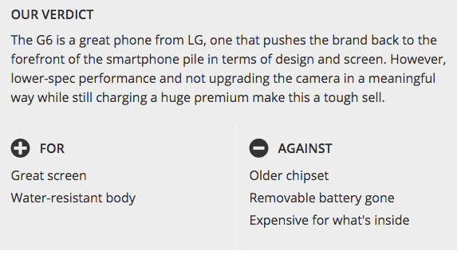
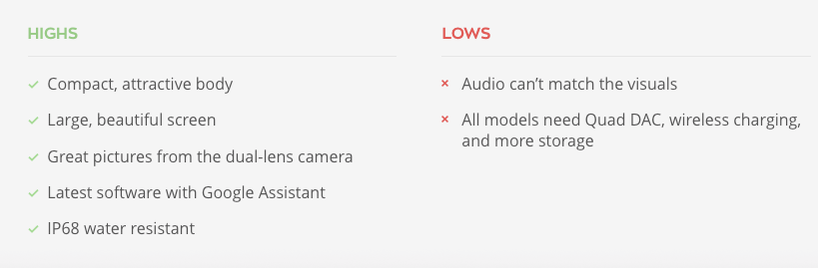

Slide 2
Keyword Extraction & Sentiment Analysis on Amazon Reviews.
By
Abhishek Yadav ( SID - 012468417 )
Suraj Khurana ( SID - 011464427 )
Sreedeep Katragadda ( SID - 011545222 )

Slide 3
Part 1
“Feature” Extraction
Phone Features = Screen, battery, Camera, Processor, Ram

Slide 4
How should we do It??
Assumption : Feature will be the most “reviewed”
It is a NOUN
Additionally,It is usually surrounded by a number. Say , “...5.5 inch Screen..”
Features of a product listed on Amazon.

Slide 5
Algorithm
Tools Used
Generated Our Algorithm : Highest Frequency Nouns!
Rake : For getting keyword using frequency
NLTK : For removing stopwords, stemming, and retaining only NOUNS!!!

Slide 6
Data and Preprocessing
Amazon Data with 1 gb.
Actual Reviews!
removed Null reviews and 1 liner reviews
Remove stop words and punctuations

Slide 7
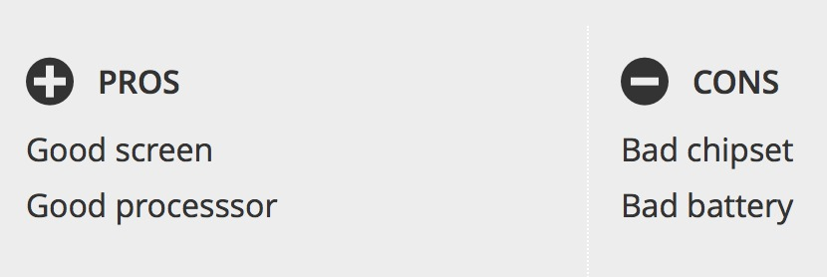
Part 2
“Sentiment” Analysis

Slide 8
How we did It??
Extract all Sentences with Keywords.
Fine Tuned Parameters.
Machine Learning : Naive Bayes Classifier
Trained with clean`t pros and cons list, From NLTK corpora
Vader : NLTK`s pretrained Algorithm
Additionally, Tried to compare 3 different Algos.
Training with Amazons whole Review as Dataset. Ratings automatically provided Labels

Slide 9
Evaluations and Demo
N Fold method
Precision
Recall
F - Score
For Actual dataset, using Amazon Review ratings to as a label and evaluating similar metrics

Slide 10
Conclusion
Successfully classified features as good or bad !

Slide 11
Future Scope
Reverse Recommendation !!

Slide 12
References
[1] https://www.researchgate.net/file.PostFileLoader.html?id=58a8166b217e2038266d4654&assetKey=AS%3A463048591843328%401487410795205
[2] http://www.nltk.org/book/ch06.html
[3] http://blog.chapagain.com.np/machine-learning-sentiment-analysis-text-classification-using-python-nltk/

Slide 13
Thank you !!

